Slide 1
Algorithm Analysis
CEN 213 Data Structures
1

Slide 2
Algorithm
An algorithm is a set of instructions to be followed to solve a problem.
  There can be more than one solution (more than one algorithm) to solve a given problem.
  An algorithm can be implemented using different programming languages on different platforms.
An algorithm must be correct. It should correctly solve the problem.
  e.g. For sorting, this means even if (1) the input is already sorted, or (2) it contains repeated elements.
Once we have a correct algorithm for a problem, we have to determine the efficiency of that algorithm.
CENG 213 Data Structures

Slide 3
Algorithmic Performance
There are two aspects of algorithmic performance:
Running Time
    Instructions take time.
    How fast does the algorithm perform?
    What affects its runtime?
Space
    Data structures take space
    What kind of data structures can be used?
    How does choice of data structure affect the runtime?
We will focus on time:
  How to estimate the time required for an algorithm
  How to reduce the time required
We will also explain how to estimate memory requirement of an algorithm
CENG 213 Data Structures

Slide 4
Analysis of Algorithms
Analysis of Algorithms is the area of computer science that provides tools to analyze the efficiency of different methods of solutions.
How do we compare the time efficiency of two algorithms that solve the same problem?
Naïve Approach: implement these algorithms in a programming language (C), and run them to compare their time requirements. Comparing the programs (instead of algorithms) has difficulties.
  How are the algorithms coded?
    Comparing running times means comparing the implementations.
    We should not compare implementations, because they are sensitive to programming style that may cloud the issue of which algorithm is inherently more efficient.
  What computer should we use?
    We should compare the efficiency of the algorithms independently of a particular computer.
  What data should the program use?
    Any analysis must be independent of specific data.
CENG 213 Data Structures

Slide 5
Analysis of Algorithms
When we analyze algorithms, we should employ mathematical techniques that analyze algorithms independently of specific implementations, computers, or data.
To analyze running time of algorithms:
  First, we start to count the number of significant operations in a particular solution to assess its efficiency.
  Then, we will express the efficiency of algorithms using growth functions.
CENG 213 Data Structures

Slide 6
The Running Time of Algorithms
Each operation in an algorithm (or a program) has a cost.
➔ Each operation takes a certain amount of time.
count = count + 1; ➔ take a certain amount of time, but it is constant
A sequence of operations:
count = count + 1; Cost: c₁
sum = sum + count; Cost: c₂
➔ Total Cost = c₁ + c₂
CEN 213 Data Structures

Slide 7
The Running Time of Algorithms (cont.)
Example: Simple If-Statement
Cost Times
if (n < 0) c1 1
result = -1*n; c2 1
else
result = n; c3 1
Total Cost <= c1 + max(c2,c3)
CEN 203 Data Structures

Slide 8
The Execution Time of Algorithms (cont.)
Example: Simple Loop
Cost Times
i = 1; c1 1
sum = 0; c2 1
while (i <= n) { c3 n+1
i = i + 1; c4 n
sum = sum + i; c5 n
}
Total Cost = c1 + c2 + (n+1)*c3 + n*c4 + n*c5
➔ The time required for this algorithm is proportional to n
CEN 213 Data Structures

Slide 9
The Execution Time of Algorithms (cont.)
Example: Nested Loop
Cost Times
i = 1; c1 1
sum = 0; c2 1
while (i <= n) { c3 n+1
j = 1; c4 n
while (j <= n) { c5 n*(n+1)
sum = sum + i; c6 n*n
j = j + 1; c7 n*n
}
i = i +1; c8 n
}
Total Cost = c1 + c2 + (n+1)*c3 + n*c4 + n*(n+1)*c5+n*n*c6+n*n*c7+n*c8
➔ The time required for this algorithm is proportional to n²
CEN 213 Data Structures

Slide 10
General Rules for Estimation
Loops: The running time of a loop is at most the running time of the statements inside of that loop times the number of iterations.
Nested Loops: Running time of a nested loop containing a statement in the inner most loop is the running time of statement multiplied by the product of the sizes of all loops.
Consecutive Statements: Just add the running times of those consecutive statements.
If/Else: Never more than the running time of the test plus the larger of running times of S1 and S2.
CEN 213 Data Structures

Slide 11
Algorithm Growth Rates
We measure an algorithm’s time requirement as a function of the problem size.
  Problem size depends on the application: e.g. number of elements in a list for a sorting algorithm, the number disks for towers of hanoi.
So, for instance, we say that (if the problem size is n)
  Algorithm A requires 5*n² time units to solve a problem of size n.
  Algorithm B requires 7*n time units to solve a problem of size n.
The most important thing to learn is how quickly the algorithm’s time requirement grows as a function of the problem size.
  Algorithm A requires time proportional to n².
  Algorithm B requires time proportional to n.
An algorithm’s proportional time requirement is known as growth rate.
We can compare the efficiency of two algorithms by comparing their growth rates.
CEN 213 Data Structures

Slide 12
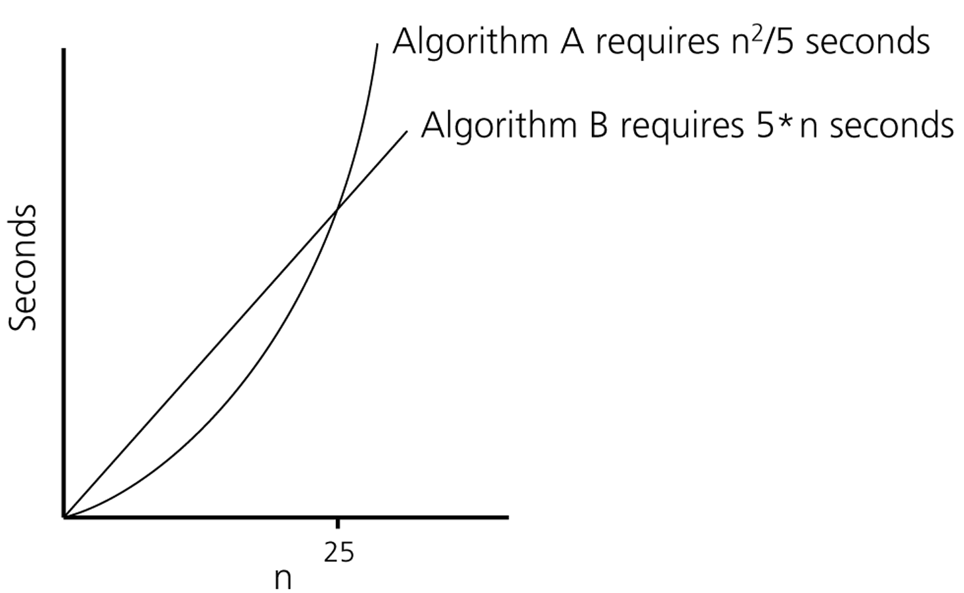
Algorithm Growth Rates (cont.)
Time requirements as a function
of the problem size n
CEN 213 Data Structures

Slide 13
Common Growth Rates
Function | Growth Rate Name
c | Constant
log N | Logarithmic
log²N | Log-squared
N | Linear
N log N | Log with linear multiplier
N² | Quadratic
N³ | Cubic
2^{N} | Exponential
N ! | Factorial
CEN 213 Data Structures

Slide 14

Figure 6.1
Running times for small inputs
CEN 213 Data Structures

Slide 15

Figure 6.2
Running times for moderate inputs
CEN 213 Data Structures

Slide 16
Order-of-Magnitude Analysis and Big O Notation
If Algorithm A requires time proportional to f(n), Algorithm A is said to be order f(n), and it is denoted as O(f(n)).
The function f(n) is called the algorithm’s growth-rate function.
Since the capital O is used in the notation, this notation is called the Big O notation.
If Algorithm A requires time proportional to n², it is O(n²).
If Algorithm A requires time proportional to n, it is O(n).
CEN 213 Data Structures

Slide 17
Definition of the Order of an Algorithm
Definition:
Algorithm A is order f(n) – denoted as O(f(n)) –
if constants c and n₀ exist such that A requires
no more than c*f(n) time units to solve a problem
of size n ≥ n₀.
The requirement of n ≥ n₀ in the definition of O(f(n)) formalizes the notion of sufficiently large problems.
  In general, many values of c and n can satisfy this definition.
CEN 213 Data Structures

Slide 18
Order of an Algorithm
If an algorithm requires n²–3 n+10 seconds to solve a problem of size n. If constants c and n₀ exist such that
c n² > n²–3 n+10 for all n ≥ n₀ .
the algorithm is order n² (In fact, c is 3 and n₀ is 2)
3 n² > n²–3 n+10 for all n ≥ 2 .
Thus, the algorithm requires no more than c*n² time units for n ≥ n₀ ,
So it is O(n²)
CEN 213 Data Structures

Slide 19
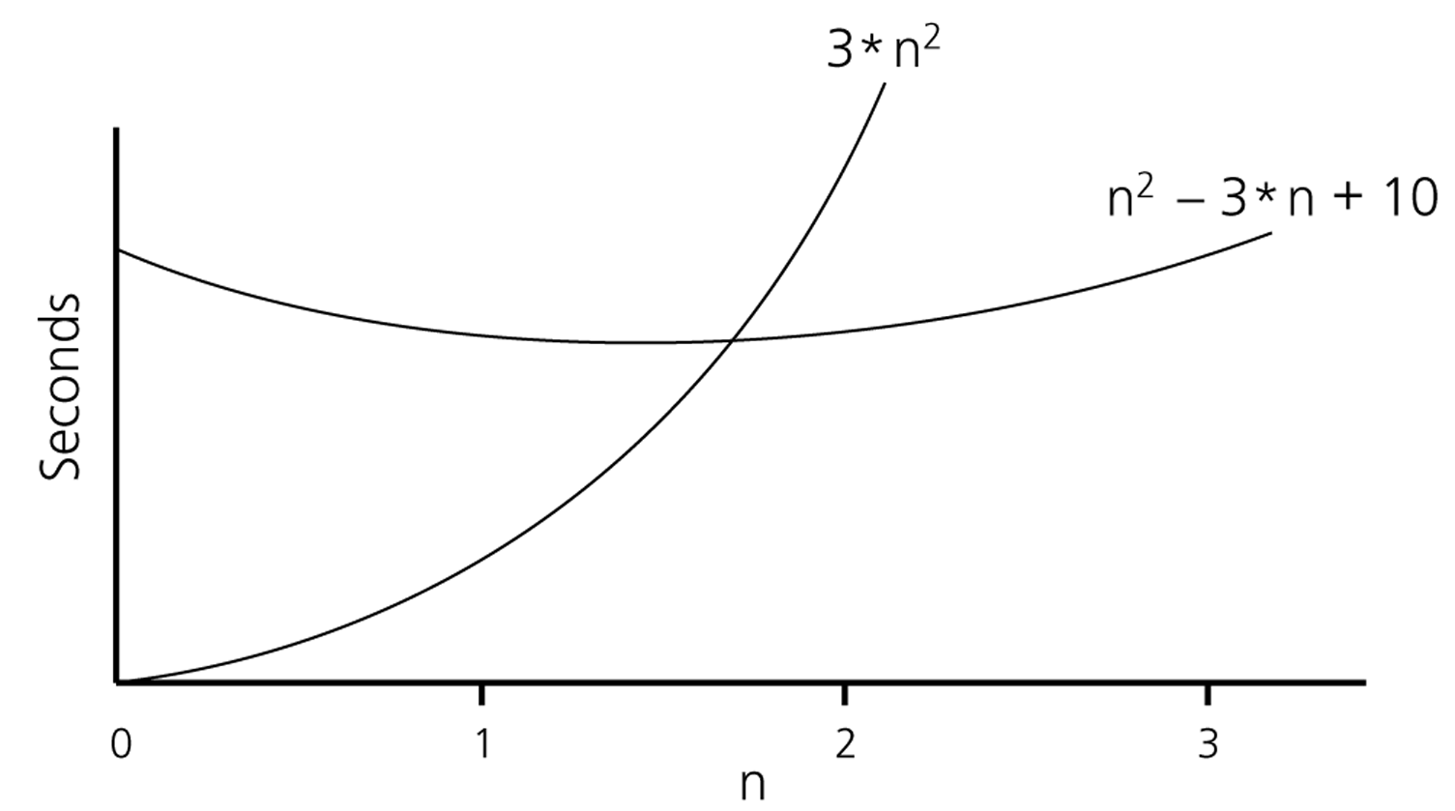
Order of an Algorithm (cont.)
CEN 213 Data Structures

Slide 20
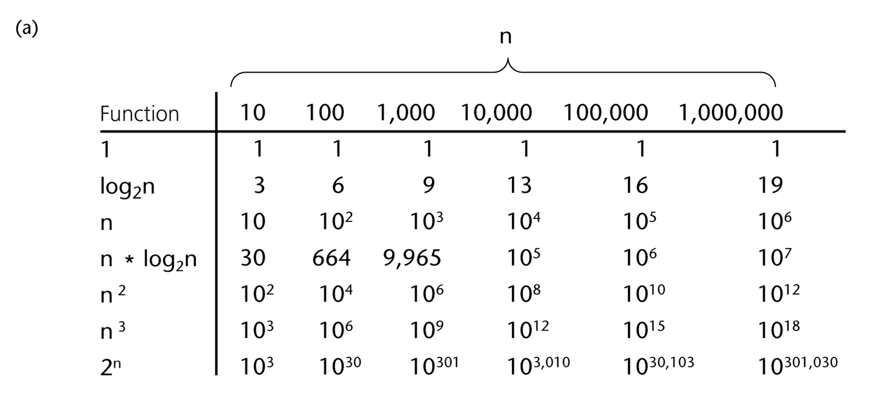
A Comparison of Growth-Rate Functions
CEN 213 Data Structures

Slide 21
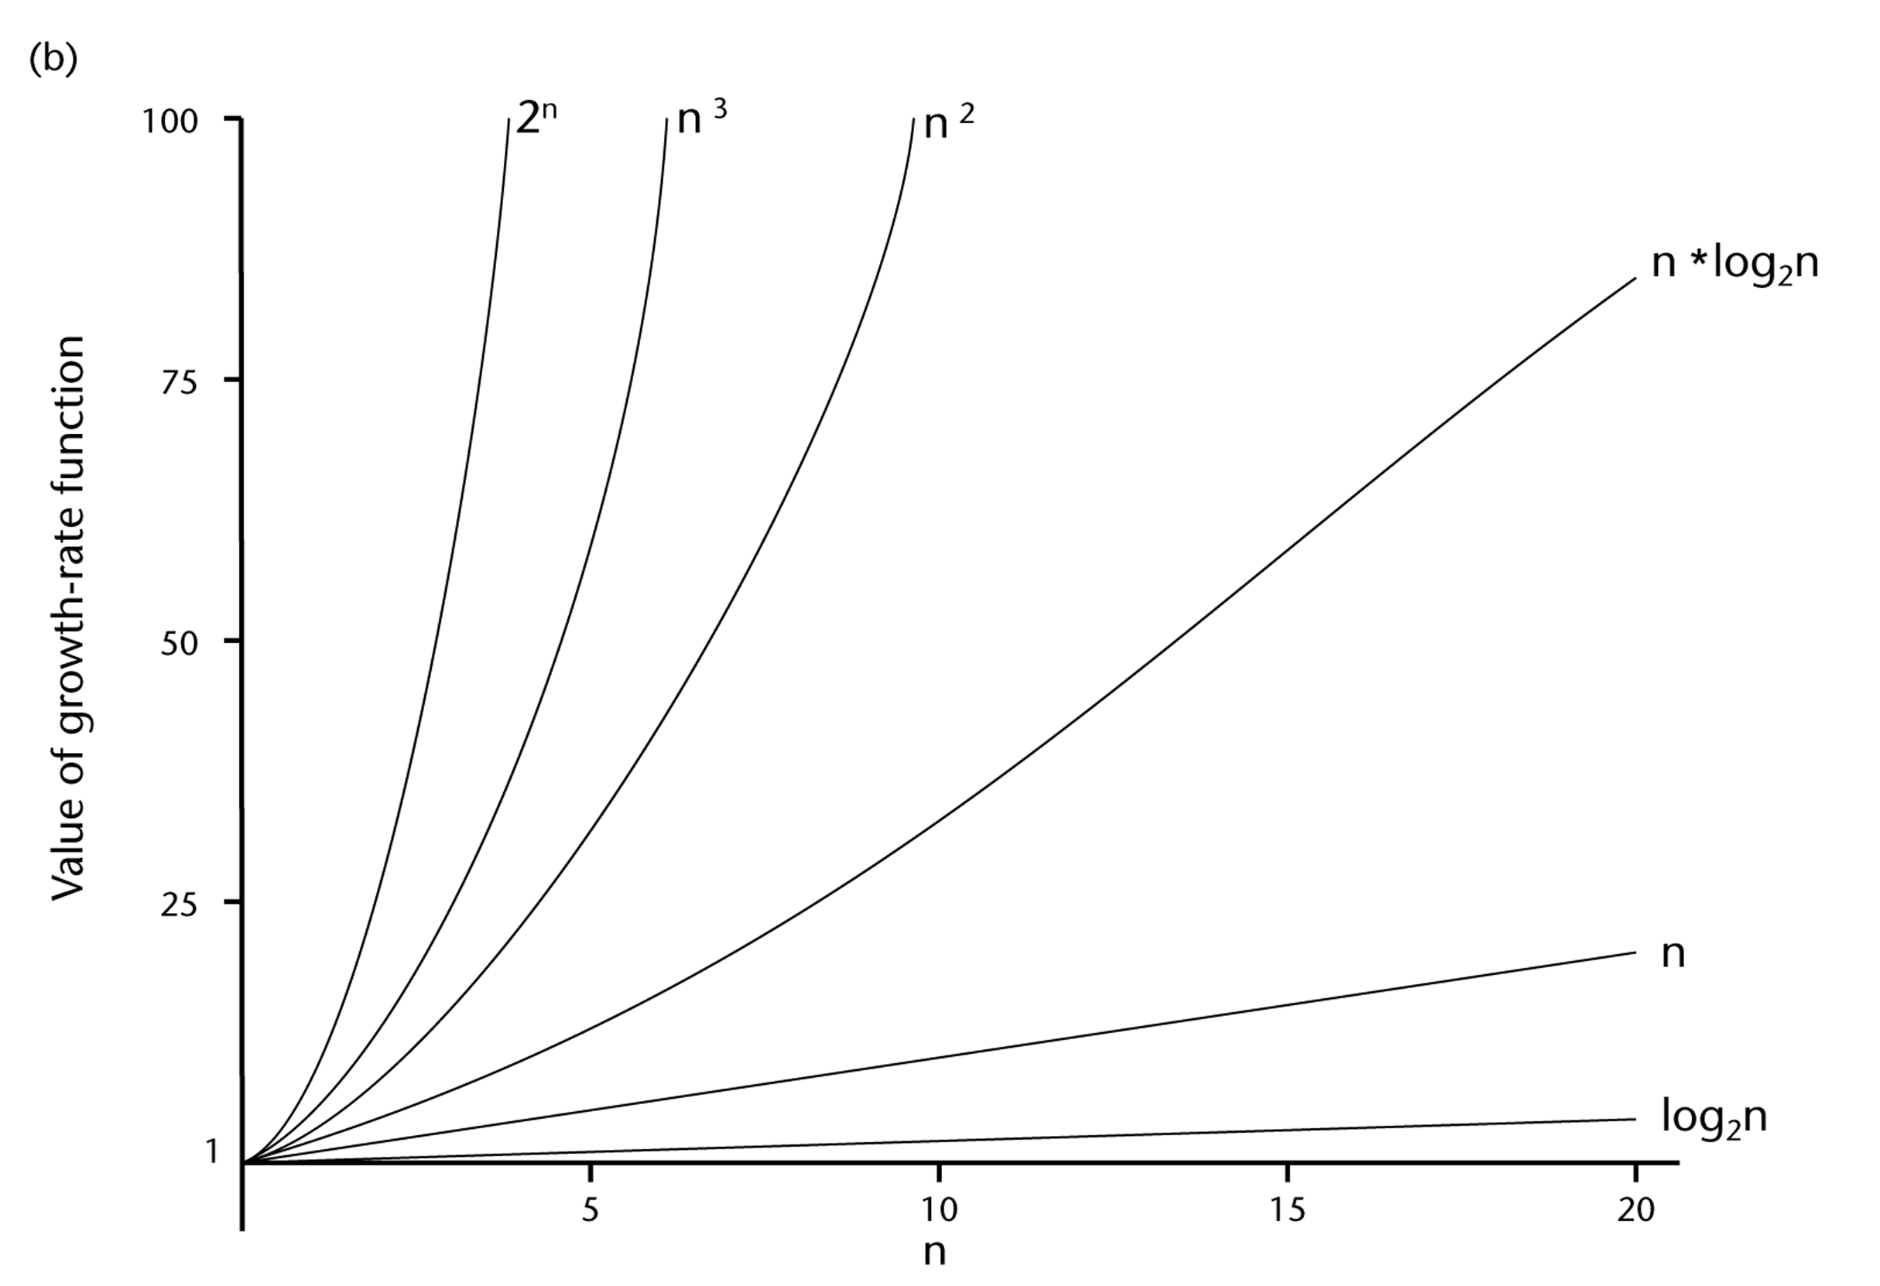
A Comparison of Growth-Rate Functions (cont.)
CEN 213 Data Structures

Slide 22
Growth-Rate Functions
O(1) Time requirement is constant, and it is independent of the problem’s size.
O(log₂n) Time requirement for a logarithmic algorithm increases slowly as the problem
size increases.
O(n) Time requirement for a linear algorithm increases directly with the size
of the problem.
O(n*log₂n) Time requirement for a n*log₂n algorithm increases more rapidly than
a linear algorithm.
O(n²) Time requirement for a quadratic algorithm increases rapidly with the
size of the problem.
O(n³) Time requirement for a cubic algorithm increases more rapidly with the
size of the problem than the time requirement for a quadratic algorithm.
O(2^{n}) As the size of the problem increases, the time requirement for an
exponential algorithm increases too rapidly to be practical.
CEN 213 Data Structures

Slide 23
Growth-Rate Functions
If an algorithm takes 1 second to run with the problem size 8, what is the time requirement (approximately) for that algorithm with the problem size 16?
If its order is:
O(1) ➔ T(n) = 1 second
O(log₂n) ➔ T(n) = (1*log₂16) / log₂8 = 4/3 seconds
O(n) ➔ T(n) = (1*16) / 8 = 2 seconds
O(n*log₂n) ➔ T(n) = (1*16*log₂16) / 8*log₂8 = 8/3 seconds
O(n²) ➔ T(n) = (1*16²) / 8² = 4 seconds
O(n³) ➔ T(n) = (1*16³) / 8³ = 8 seconds
O(2^{n}) ➔ T(n) = (1*2¹⁶) / 2⁸ = 2⁸ seconds = 256 seconds
CEN 213 Data Structures

Slide 24
Properties of Growth-Rate Functions
We can ignore low-order terms in an algorithm’s growth-rate function.
  If an algorithm is O(n³+4n²+3n), it is also O(n³).
  We only use the higher-order term as algorithm’s growth-rate function.
We can ignore a multiplicative constant in the higher-order term of an algorithm’s growth-rate function.
  If an algorithm is O(5n³), it is also O(n³).
O(f(n)) + O(g(n)) = O(f(n)+g(n))
  We can combine growth-rate functions.
  If an algorithm is O(n³) + O(4n), it is also O(n³ +4n) ➔ So, it is O(n³).
  Similar rules hold for multiplication.
CEN 213 Data Structures

Slide 25
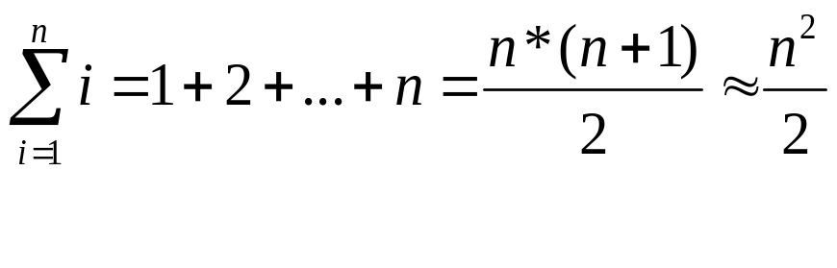
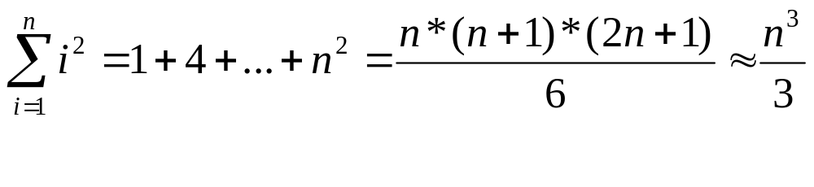
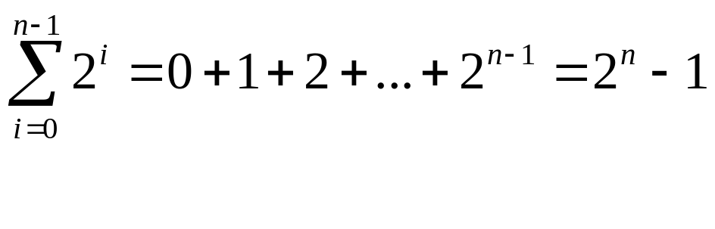
Some Mathematical Facts
Some mathematical equalities are:
CEN 213 Data Structures

Slide 26
Growth-Rate Functions – Example1
# of operations Times
i = 1; 1 1
sum = 0; 1 1
while (i <= n) { 1 n+1
i = i + 1; 2 n
sum = sum + i; 2 n
}
T(n) = 1 + 1 + (n+1)*1 + n*2 + n*2
= (1+2+2)*n + (1+1+1)
= 5*n + 3
➔ So, the growth-rate function for this algorithm is O(n)
CEN 213 Data Structures

Slide 27
Growth-Rate Functions – Example2
# of operations Times
i=1; 1 1
sum = 0; 1 1
while (i <= n) { 1 n+1
j=1; 1 n
while (j <= n) { 1 n*(n+1)
sum = sum + i; 2 n*n
j = j + 1; 2 n*n
}
i = i +1; 2 n
}
T(n) = 1 + 1 + (n+1)*1 + n*1 + n*(n+1)*1 + n*n*1 + n*n*2 + n*2
= (1+1+2)*n² + (1+1+1+2)*n + (1+1+1)
= 4*n² + 5*n + 3
➔ So, the growth-rate function for this algorithm is O(n²)
CEN 213 Data Structures

Slide 28
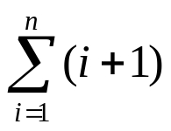

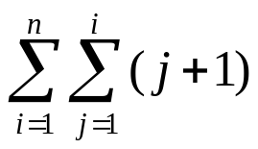
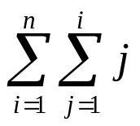
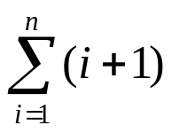
Growth-Rate Functions – Example3
# of operations Times
for (i=1; i<=n; i++) 1,1,1 1,n+1,n
for (j=1; j<=i; j++) 1,1,1 n, ,
for (k=1; k<=j; k++) 1,1,1 , ,
x=x+1; 2
T(n) = 1+ 1*(n+1) + 1*n + 1*n + 1*( ) + 1* ( ) + 1*( ) +
1*( ) + 1* ( ) + 2 * ( )
= a*n³ + b*n² + c*n + d
➔ So, the growth-rate function for this algorithm is O(n³)
CEN 213 Data Structures

Slide 29
Growth-Rate Functions – Example 4
Running time analysis of a function that computes the average of the elements of an array.
1 float computeAvg(float A[ ], int n){
2 float avg, total=0;
3 int k;
4 for (k = 0; k < n; k++)
5 total = total + A[k];
6 avg = total / n;
7 return(avg);
}
CEN 213 Data Structures

Slide 30
Growth-Rate Functions – Example 5
Running time analysis of findMin( ) function which finds and returns the minimum element of an array having n element.
1 float findMin(float A[ ], int n){
2 float min;
3 int k;
4 min = A[0];
5 for (k = 1; k < n; k++){
6 if (A[k] < min){
7 min = A[k];
8 }
9 }
10 return min;
}
CEN 213 Data Structures

Slide 31
Growth-Rate Functions – Example 6
Running time analysis of MatrixSum( ) function which adds 2 n*m matrices A and B into matrix C.
void matrixSum(int A[ ][100], int B[ ][100], int C[ ][100], int n, int m){
int i, j;
for (i = 0; i < n; i++){
for (j = 0; j < m; j++){
C[i][j] = A[i][j] + B[i][j];
}
}
}
CEN 213 Data Structures

Slide 32
Growth-Rate Functions – Recursive Algorithms
void hanoi(int n, char source, char dest, char spare) { #of op.
if (n > 0) { 1
hanoi(n-1, source, spare, dest); c1
printf("Move top disk from pole %c 1
to pole %c\n ", source, dest);
hanoi(n-1, spare, dest, source); c2
} }
The time-complexity function T(n) of a recursive algorithm is defined in terms of itself, and this is known as recurrence equation for T(n).
To find the growth-rate function for a recursive algorithm, we have to solve its recurrence relation.
CEN 213 Data Structures

Slide 33
Growth-Rate Functions – Hanoi Towers
What is the cost of hanoi(n,’A’,’B’,’C’)?
when n=0
T(0) = 1
when n>0
T(n) = 1 + c1 + T(n-1) + 1 + c2 + T(n-1)
= 2*T(n-1) + (1+c1+1+c2)
= 2*T(n-1) + c ⬅ recurrence equation for the growth-rate function of hanoi-towers algorithm
Now, we have to solve this recurrence equation to find the growth-rate function of hanoi-towers algorithm
CEN 213 Data Structures

Slide 34
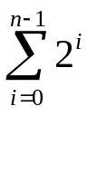
Growth-Rate Functions – Hanoi Towers (cont.)
There are many methods to solve recurrence equations, but we will use a simple method known as repeated substitutions.
T(n) = 2*T(n-1) + c
= 2 * (2*T(n-2)+c) + c
= 2 * (2* (2*T(n-3)+c) + c) + c
= 2³ * T(n-3) + (2²+2¹+2⁰)*c (assuming n>2)
when substitution repeated i-1th times
= 2^{i} * T(n-i) + (2^{i-1}+ ... +2¹+2⁰)*c
when i=n
= 2^{n} * T(0) + (2^{n-1}+ ... +2¹+2⁰)*c
= 2^{n} * c1 + ( )*c
= 2^{n} * c1 + ( 2^{n}-1 )*c = 2^{n}*(c1+c) – c ➔ So, the growth rate function is O(2^{n})
CEN 213 Data Structures

Slide 35
What to Analyze
An algorithm can require different times to solve different problems of the same size.
  Eg. Searching an item in a list of n elements using sequential search. ➔ Cost: 1,2,...,n
Worst-Case Analysis –The maximum amount of time that an algorithm require to solve a problem of size n.
  This gives an upper bound for the time complexity of an algorithm.
  Normally, we try to find worst-case behavior of an algorithm.
Best-Case Analysis –The minimum amount of time that an algorithm require to solve a problem of size n.
  The best case behavior of an algorithm is NOT so useful.
Average-Case Analysis –The average amount of time that an algorithm require to solve a problem of size n.
  Sometimes, it is difficult to find the average-case behavior of an algorithm.
  We have to look at all possible data organizations of a given size n, and their distribution probabilities of these organizations.
  Worst-case analysis is more common than average-case analysis.
CEN 213 Data Structures

Slide 36
Memory Requirement of a Computer Program
It is the amount of memory that is needed to run the program.
It involves three components:
Memory requirement of the source code: equal to the size of the .exe file of the source code. It can be computed after the source code is compiled.
Memory requirement of the data: is the amount of memory to store the variables, data structures, and the arrays of the source code. We can compute this value.
Memory requirement of the program stack: If the source code does not include a recursive function, we can ignore this memory requirement.
→ So, do not use recursion!
CEN 213 Data Structures

Slide 37
Example
Compute the memory requirement of data used in the below source code:
main(){ # of bytes needed
int A[20] = {7, 62, 3, 21, …}; 20 * 4
int k, sum; 4 + 4
float avg; 4
for (k = 0; k < 20; k++)
sum += A[k];
avg = sum / 20.0;
printf("Average of the 20 elements=%f\n", avg);
}
→ Total bytes for the data = 80 + 8 + 4 = 92 bytes.
CEN 213 Data Structures

Slide 38
What is Important?
If the problem size is always small, we can probably ignore the algorithm’s efficiency.
  In this case, we should choose the simplest algorithm.
We have to weigh the trade-offs between an algorithm’s time requirement and its memory requirements.
We have to compare algorithms for both style and efficiency.
  The analysis should focus on gross differences in efficiency and not reward coding tricks that save small amount of time.
  That is, there is no need for coding tricks if the gain is not too much.
  Easily understandable program is also important.
Order-of-magnitude analysis focuses on large problems.
CEN 213 Data Structures

